Slide 1
D-310 Unit 8: Demobilization
Notes:
Alaska Fire Crews arrive at NIFC | Crew bags lined up on the… | Flickr

Slide 2
Objectives
Students will be able to:
Identify basic elements of the demobilization process.
Identify conditions/situations which may limit resource availability for reassignment.
Describe the demobilization information flow at the expanded dispatch, Geographic Area Coordination Center (GACC), and national levels.
List the information required to place a request for demobilization transportation.

Slide 3

Incident Position Standards Alignment
This unit aligns with the following Expanded Dispatch Support Dispatcher (EDSD) Incident Position Standards located at
https://www.nwcg.gov/positions/expanded-dispatch-support-dispatcher/standards-and-references.
EDSD responsibility alignment
Communicate and manage resources in preparation for reassignment or demobilization.
Prepare for and implement demobilization.

Slide 4
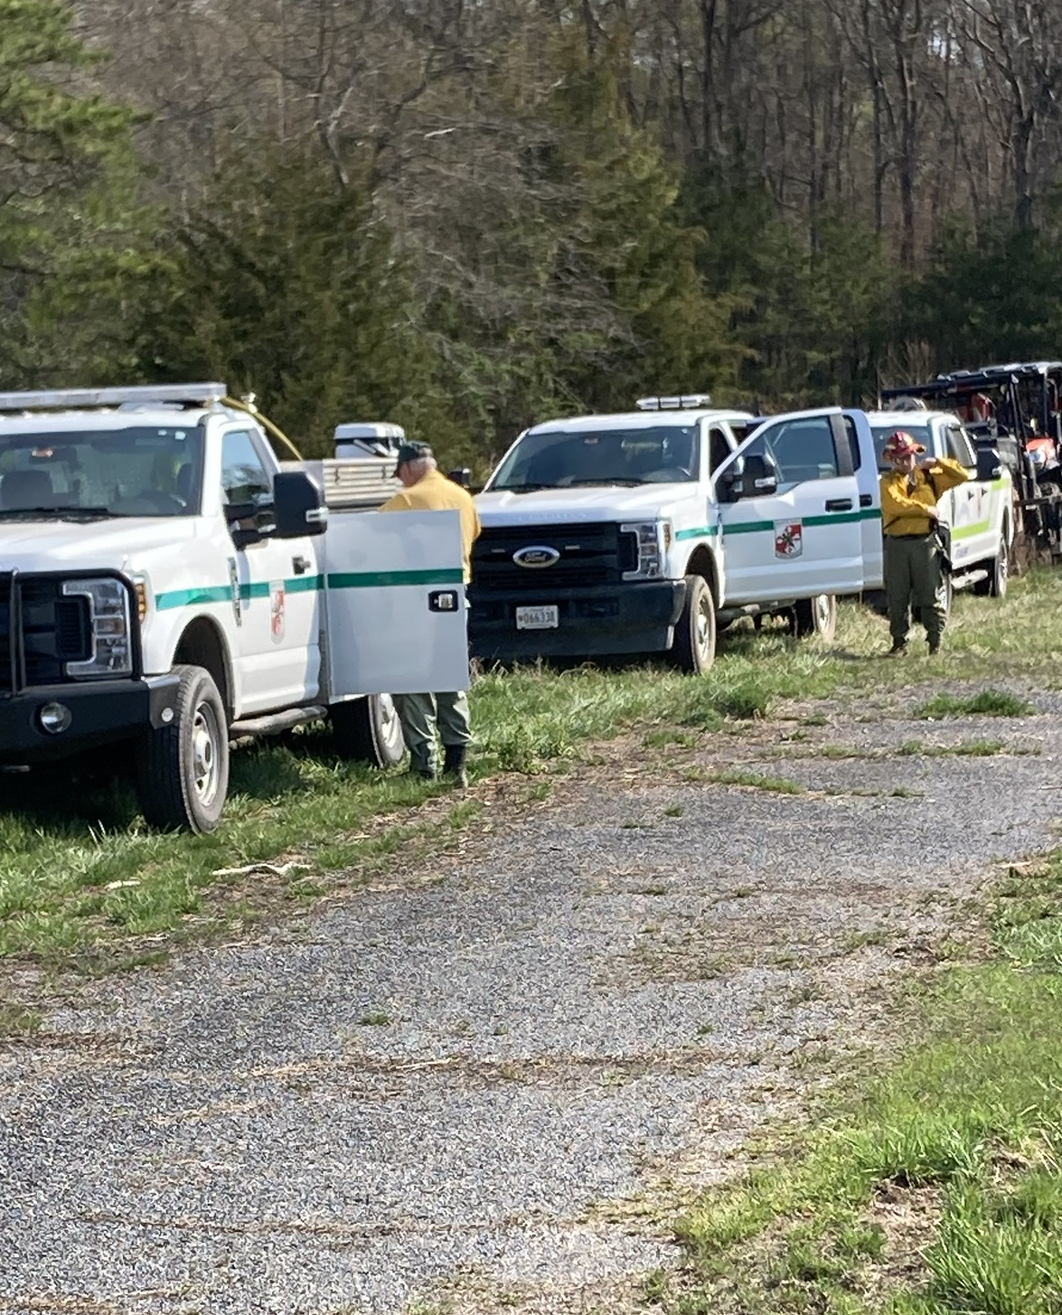
Demobilization
The safe and orderly release of resources from the incident in a cost-effective, efficient manner that requires coordination between the incident and expanded dispatch.

Slide 5
Demobilization Considerations
Be safe
Involve planning
Be cost effective
Consider all resources assigned

Slide 6
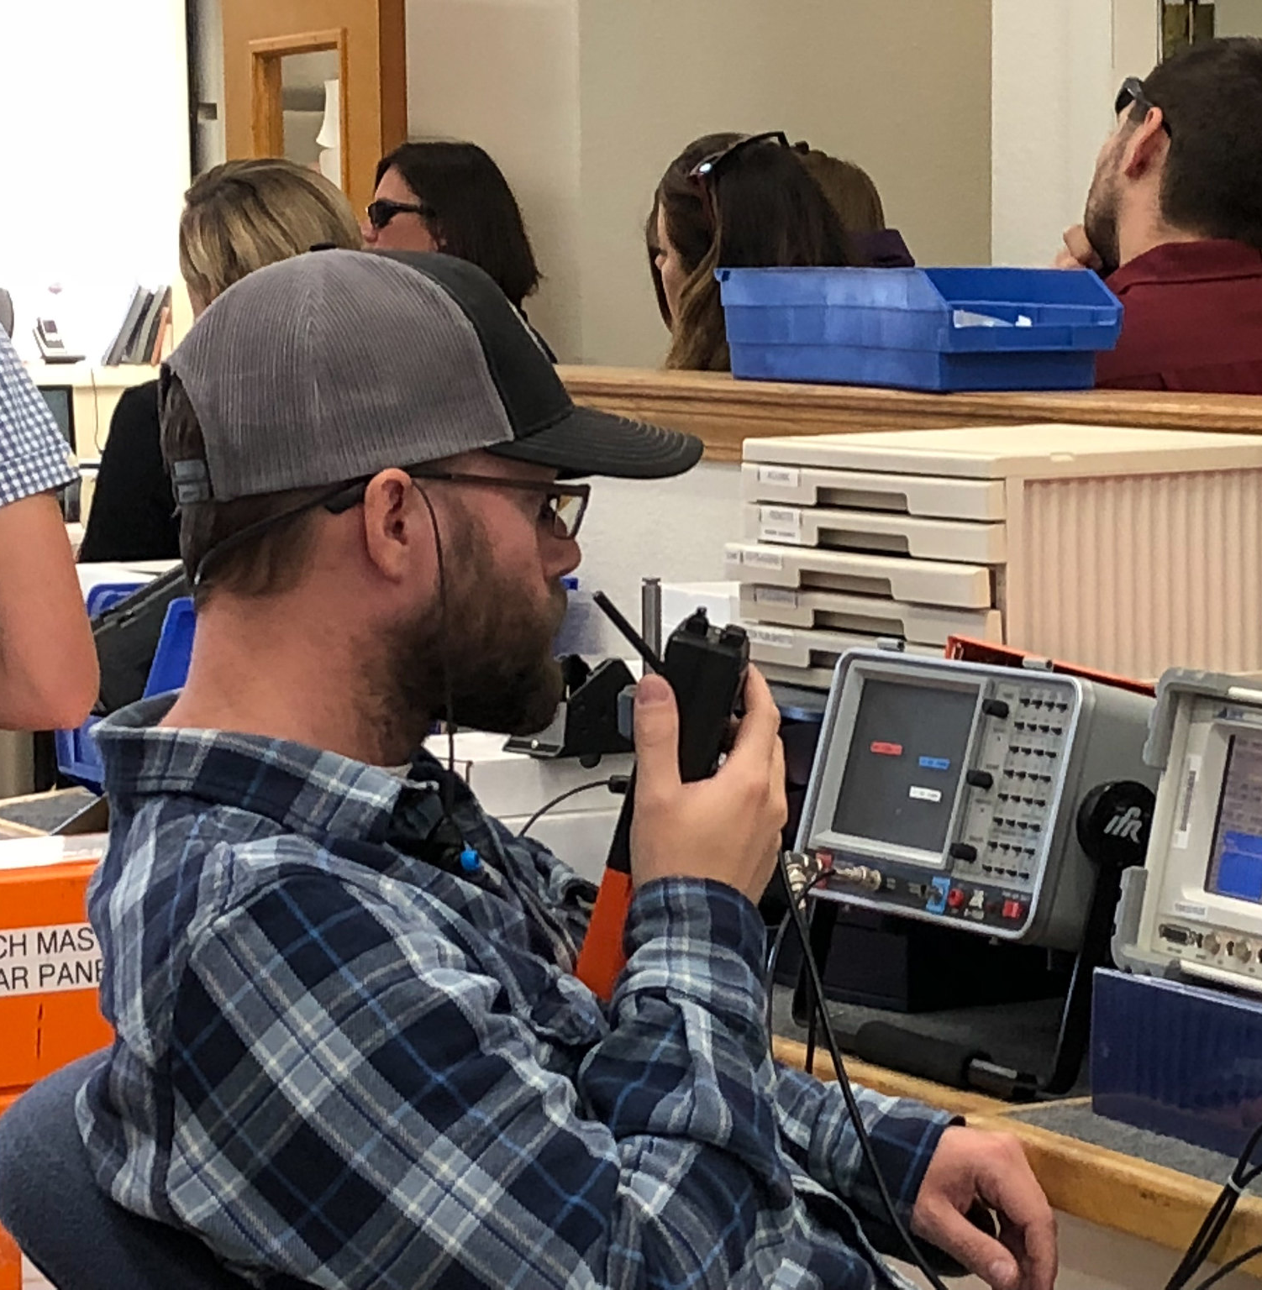
Communication
Present a professional attitude and work ethic.
Work closely with each dispatch level, incident, area command, etc.
Help each other and work together.
Notes:
On the campus of the National Interagency Fire Center. | Flickr

Slide 7
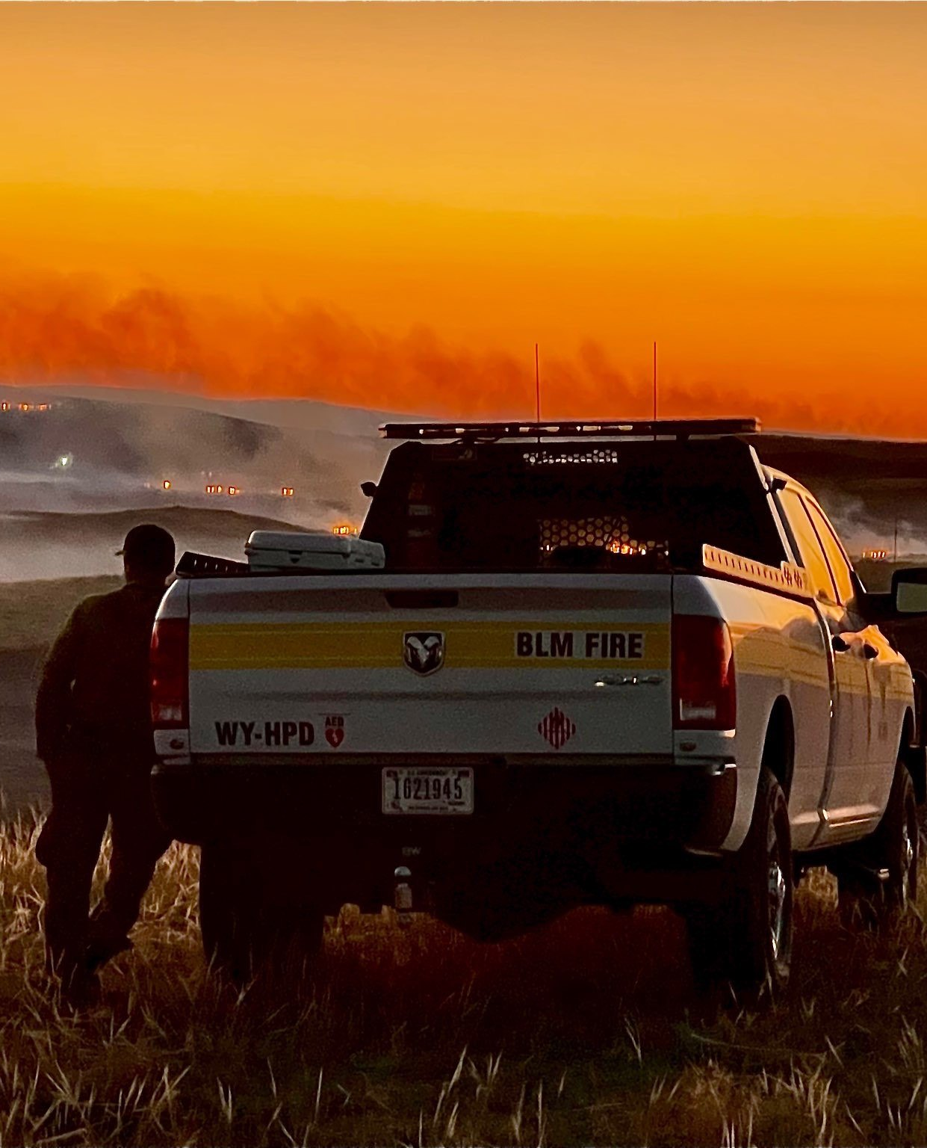
Demobilization Plans
The Planning Section on the incident is responsible for creating the demobilization plan.
The incident’s demobilization plan must follow national, geographic, and local demobilization guidelines.
Notes:
2022 BLM Fire Employee Photo Contest Category - Fire Perso… | Flickr

Slide 8
Demobilization Process
Planning at the incident
Demobilization Plan
Incident Action Plan (IAP)
Implementation at the incident
Surplus resources (checked against other orders)

Slide 9
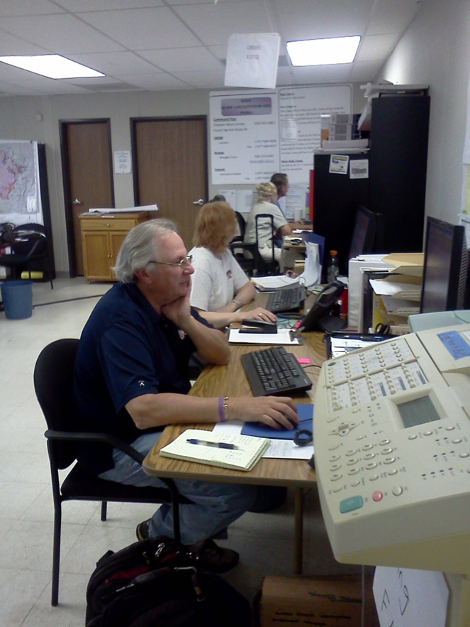
Expanded Dispatch Level

Slide 10
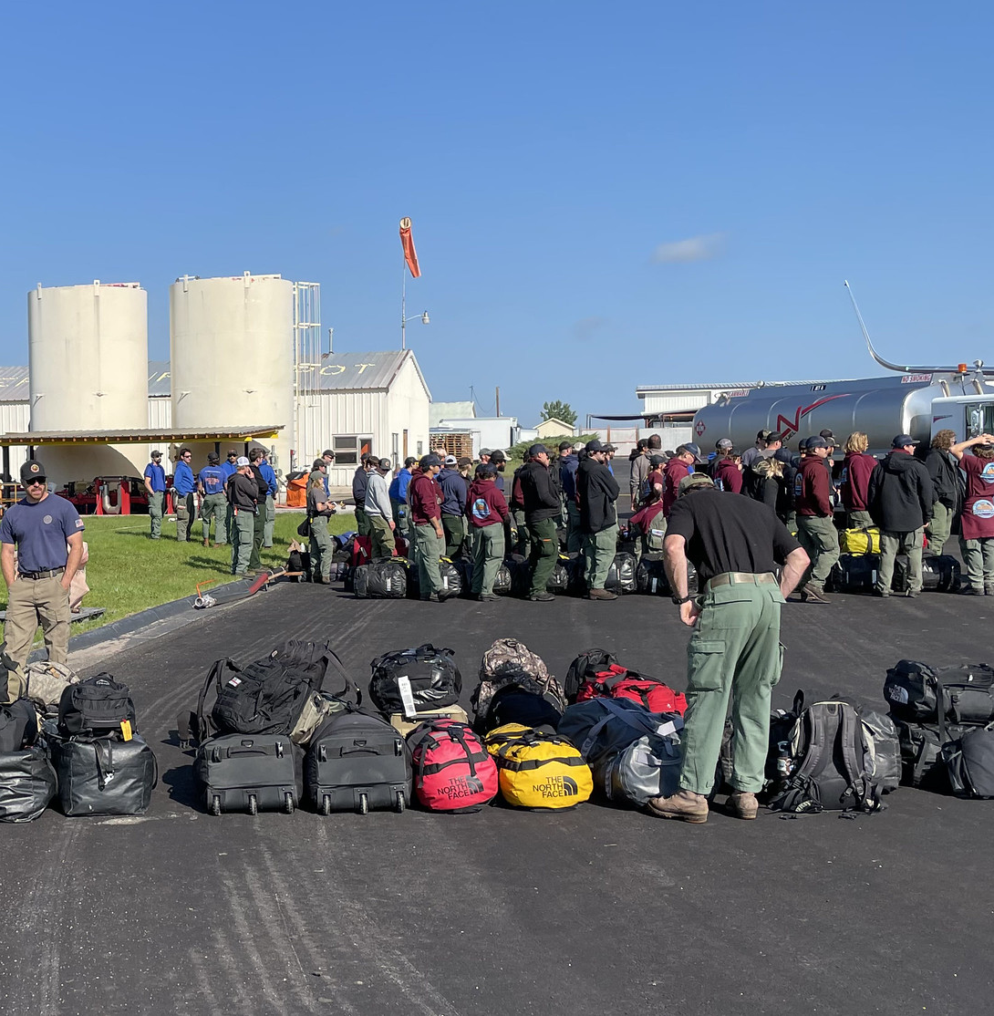
Local Reassignment
To the same incident in a different position or another incident.
To a mobilization center.
To a staging area.
Notes:
Supporting Canada 2 | Firefighting resources loading a plane… | Flickr

Slide 11
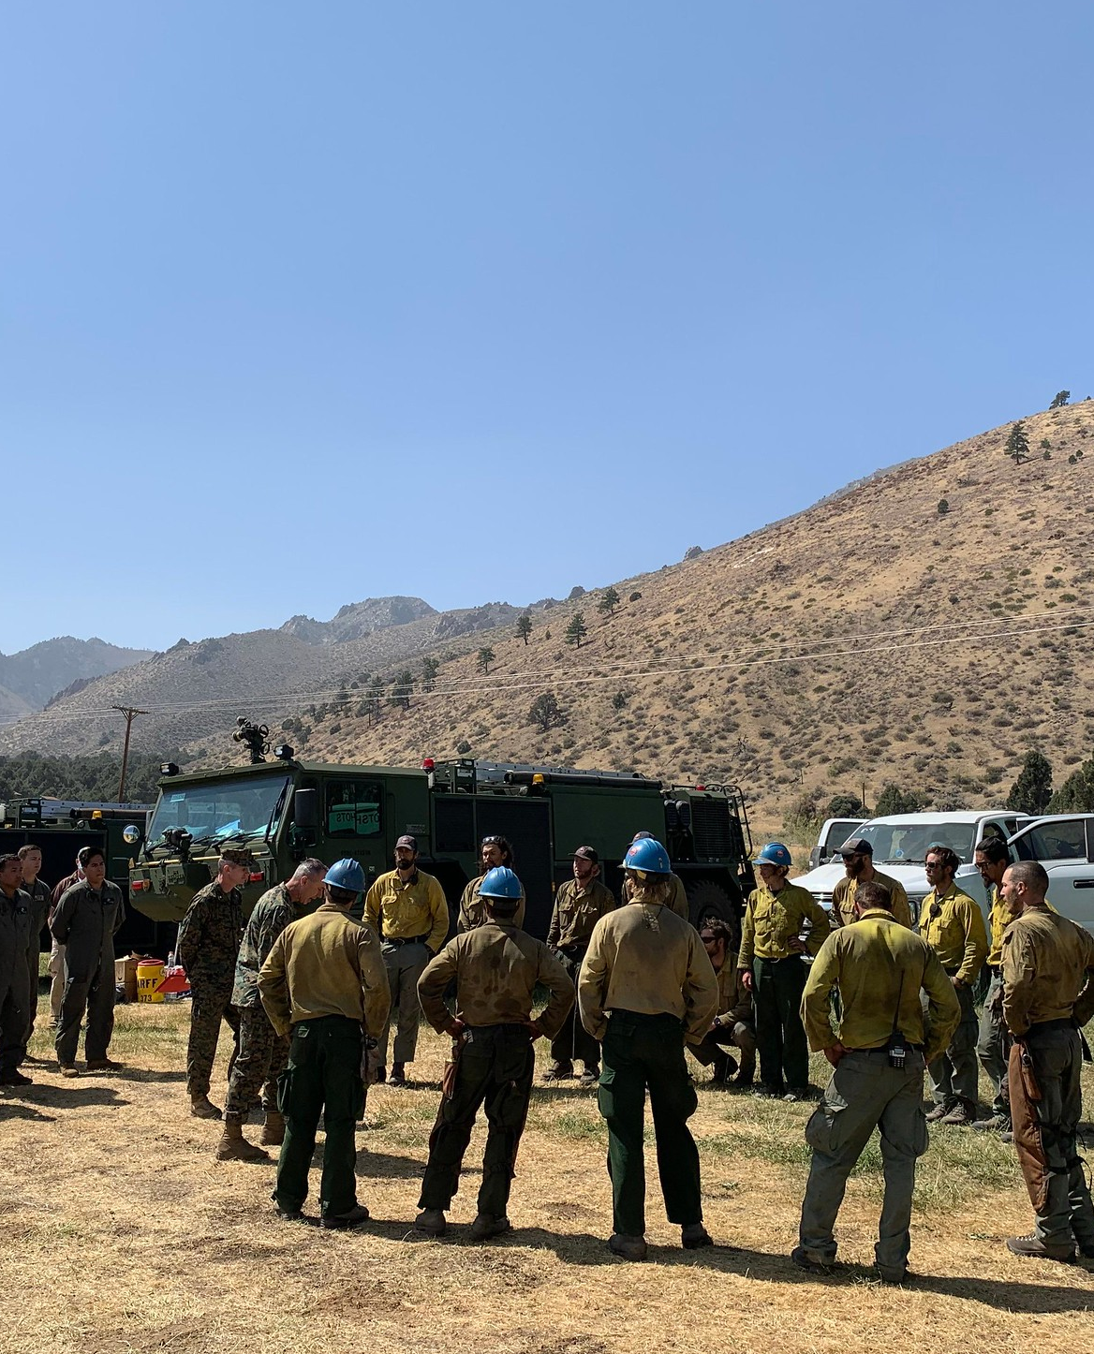
Reassignment and Availability
Identify conditions which may limit availability for reassignments.
Notes:
Slink Fire | Marine Corps gave an appreciation letter to the… | Flickr

Slide 12
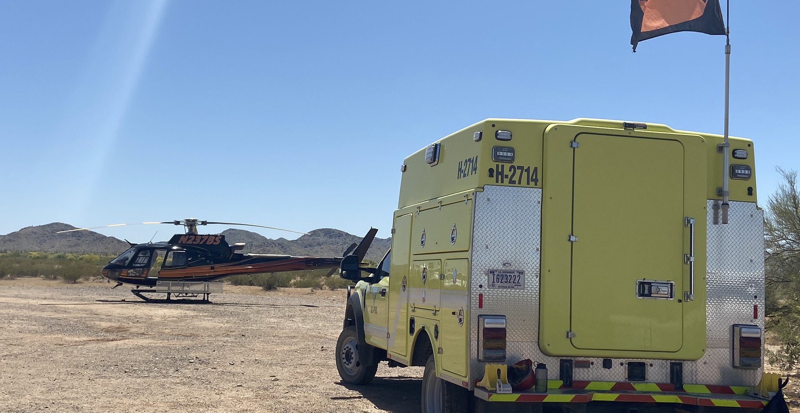
Transportation
Identify the process required to release resources.
Notes:
Hermits Peak and Calf Canyon BAER | BAER Team members and NR… | Flickr

Slide 13
Information Required to Arrange Transportation
Incident order and request numbers
Number of people
Manifest/roster
Names and weights (personnel and baggage weighed separately)
Date, time, and pickup point
Destination (jetport and home unit location)
Support along the way

Slide 14
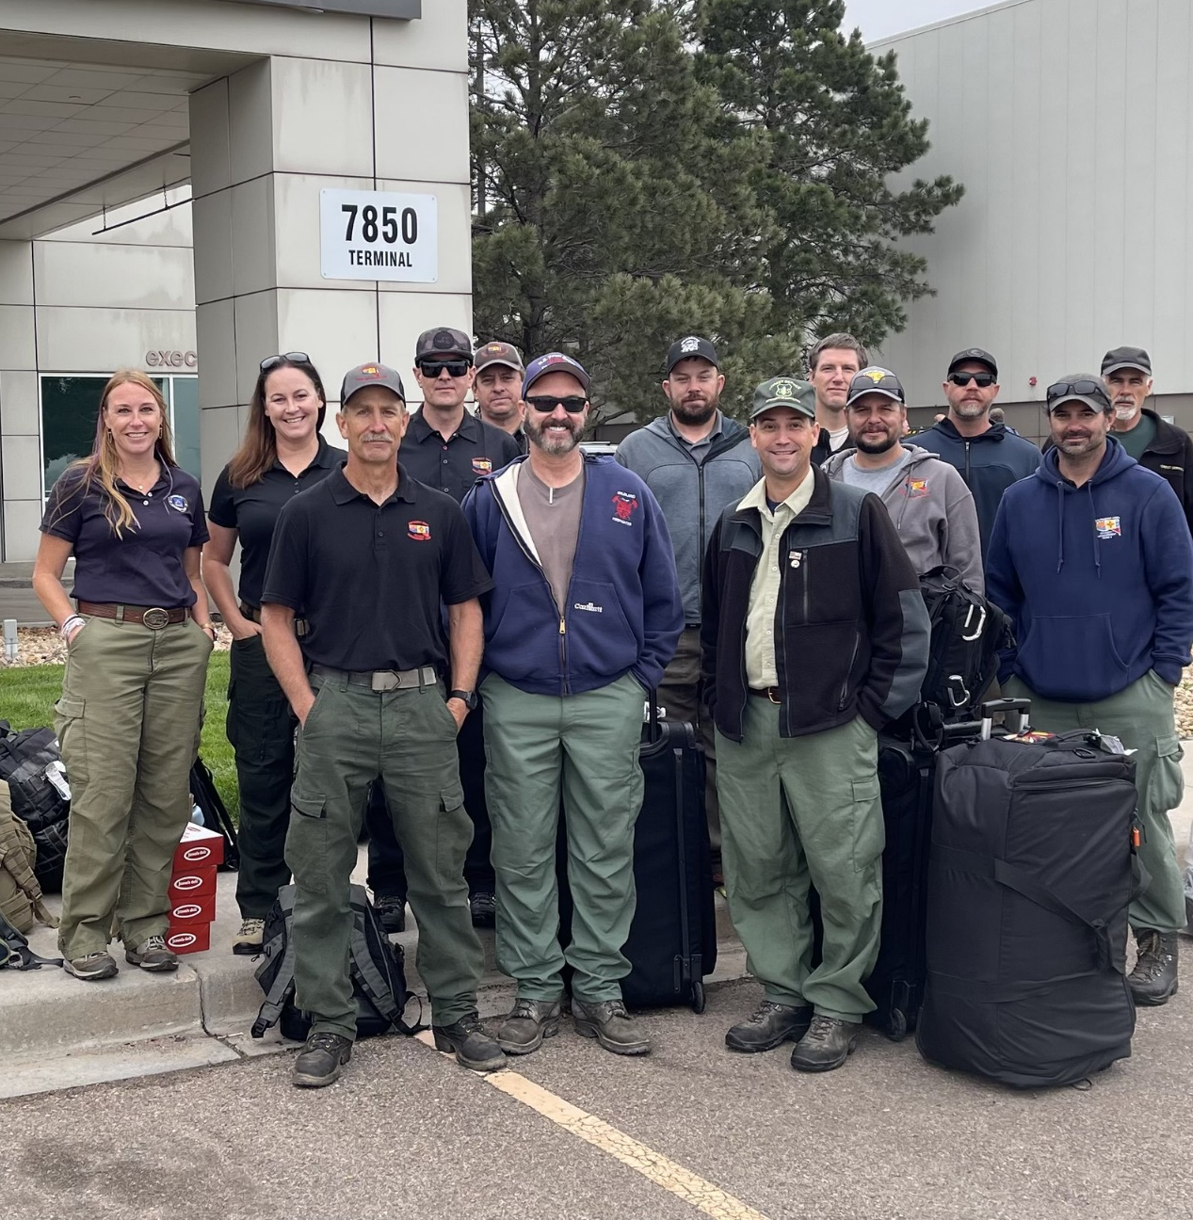
Transportation Needs
Local contacts
Aircraft Dispatcher (ACDP)
Equipment dispatcher
Designated travel agency
Non-local contacts
GACC to National Interagency Coordination Center (NICC) for large aircraft
Notes:
Firefighters Take Off for Canada | Wildland firefighters and… | Flickr

Slide 15
Relaying Travel Plans
If travel arrangements are made at another dispatch level, document and pass the travel information required on to the following:
Ground support and/or equipment dispatcher
Local mobilization center or staging area

Slide 16
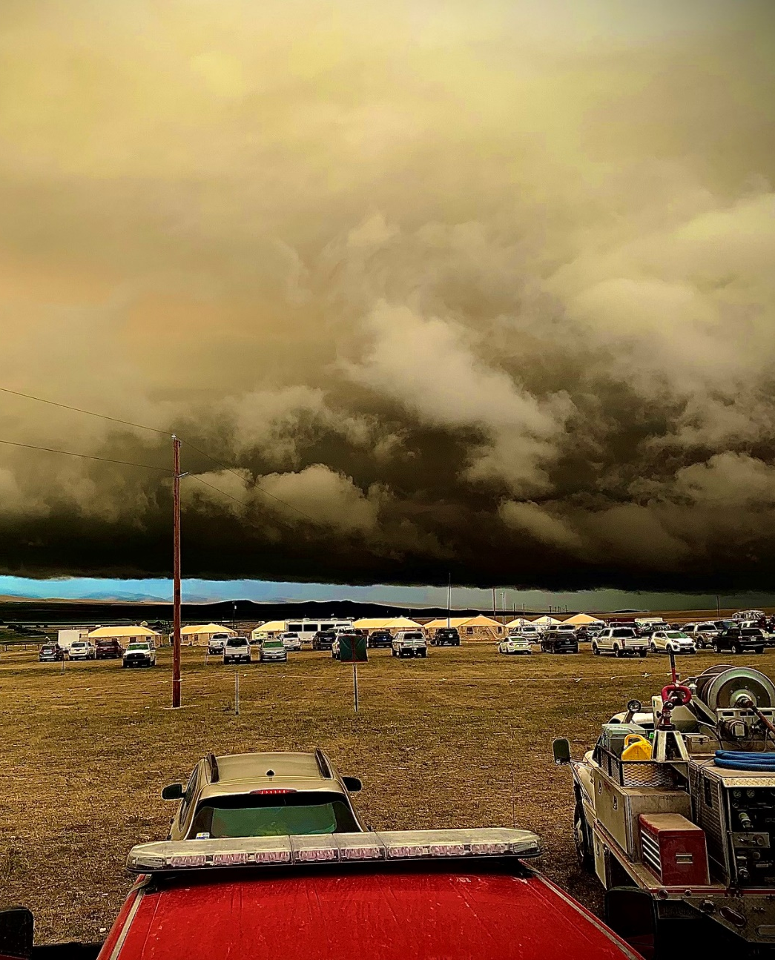
Potential Demobilization Problems
Weather (lightning creating new starts)
Personnel on the incident without a resource order
Incorrect jetports
Inaccurate manifest
Duplicate orders for personnel
Failure to establish priorities
Notes:
Storm Over Wood Creek Fire | A beautiful and powerful storm … | Flickr

Slide 17
Resources that Help During Demobilization
Interagency Resource Representative (IARR)
Incident Contract Project Inspector (ICPI)
Cache Demobilization Specialist (CDSP)
Other dispatch offices
Demobilization Unit
Interagency Resource Ordering Capability (IROC) or resource tracking applications (e.g., e-ISuite)

Slide 18
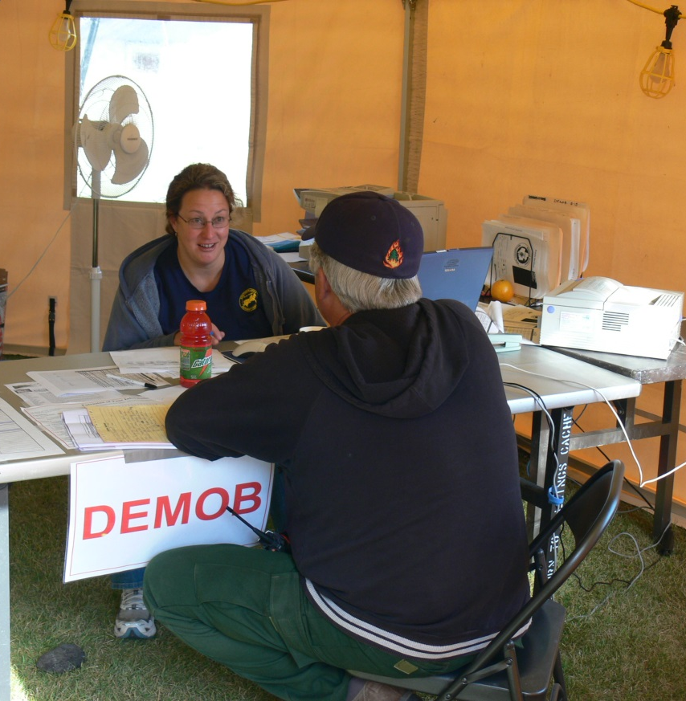
Demobilization Summary
Ensure requests are processed to their final state.
Cancel outstanding orders.
Finish all travel.
Release all resources.
Follow local procedures.

Slide 19
Summary
Demobilization starts at mobilization.
The Planning Section on the incident is responsible for creating the Demobilization Plan.
Demobilization starts at the incident with the Demobilization Unit Leader (DMOB) who prepares the Demobilization Plan, outlining the priorities on the incident.
Demobilization at the expanded dispatch level involves checking with other incidents with open orders for possible resource reassignment.
Transportation needs are based on information from the original request and other information you may have received from the incident.
The following resources help during the demobilization process: IARR, ICPI, other dispatch offices, Demobilization Unit, IROC, or resource tracking applications (e.g., e-ISuite).
Ensure requests are processed to their final state.

